Slide 1

Introduction to PHP

Slide 2
PHP Arrays
> An array variable is a storage area holding a number or text. The problem is, a variable will hold only one value.
> An array is a special variable, which can store multiple values in one single variable.

Slide 3

PHP Arrays
If you have a list of items (a list of car names, for example), storing the cars in single variables could look like this:

Slide 4
PHP Arrays
> However, what if you want to loop through the cars and find a specific one? And what if you had not 3 cars, but 300?
> The best solution here is to use an array.
> An array can hold all your variable values under a single name. And you can access the values by referring to the array name.
> Each element in the array has its own index so that it can be easily accessed.

Slide 5
PHP Arrays
In PHP, there are three kind of arrays:
> Numeric array - An array with a numeric index
> Associative array - An array where each ID key is associated with a value
> Multidimensional array - An array containing one or more arrays

Slide 6
PHP Numeric Arrays
> A numeric array stores each array element with a numeric index.
> There are two methods to create a numeric array.

Slide 7


PHP Numeric Arrays
In the following example the index is automatically assigned (the index starts at 0):
In the following example we assign the index manually:

Slide 8
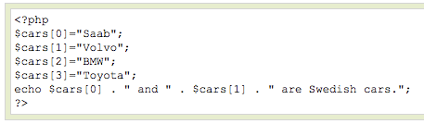

PHP Numeric Arrays
In the following example you access the variable values by referring to the array name and index:
The code above will output:

Slide 9
PHP Associative Arrays
> With an associative array, each ID key is associated with a value.
> When storing data about specific named values, a numerical array is not always the best way to do it.
> With associative arrays we can use the values as keys and assign values to them.

Slide 10

PHP Associative Arrays
In this example we use an array to assign ages to the different persons:
This example is the same as the one above, but shows a different way of creating the array:

Slide 11
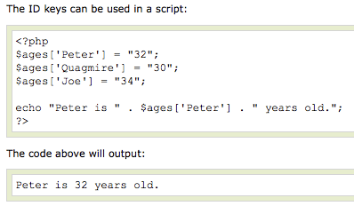
PHP Associative Arrays

Slide 12
PHP Multidimensional Arrays
In a multidimensional array, each element in the main array can also be an array.
And each element in the sub-array can be an array, and so on.

Slide 13
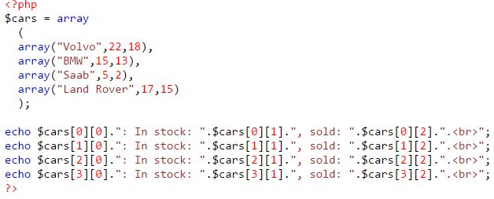
PHP Multidimensional Arrays
Volvo: In stock: 22, sold: 18. BMW: In stock: 15, sold: 13. Saab: In stock: 5, sold: 2. Land Rover: In stock: 17, sold: 15.

Slide 14
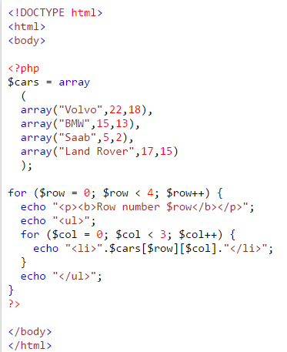
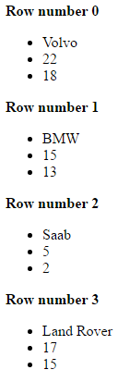
PHP Multidimensional Arrays

Slide 15
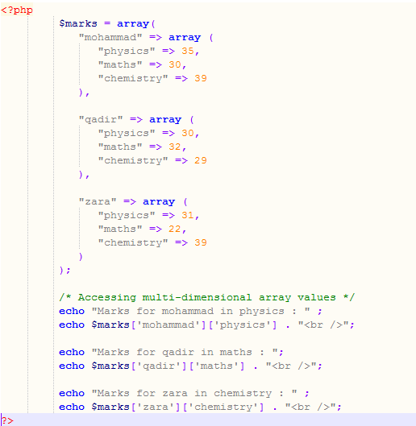

PHP Multidimensional Arrays

Slide 16
Insert Element in Array
array_push() function inserts one or more elements to the end of an array.
Syntax
array_push(array,value1,value2...)
array_slice() function returns selected parts of an array
Syntax
array_slice (array, start, length, preserve)
Parameter | Description
array | Required. Specifies an array
start | Required. Numeric value. Specifies where the function will start the slice. 0 = the first element. If this value is set to a negative number, the function will start slicing that far from the last element. -2 means start at the second last element of the array.
length | Optional. Numeric value. Specifies the length of the returned array. If this value is not set, the function will return all elements, starting from the position set by the start-parameter.
preserve | Optional. Specifies if the function should preserve or reset the keys. Possible values: true - Preserve keys, false - Default. Reset keys

Slide 17
Removing values from arrays
> Sometimes you need to completely remove an element from an array. For example, suppose you have the following array with five elements:
$cities[0] = “Phoenix”;
$cities[1] = “Tucson”;
$cities[2] = “Flagstaff”;
$cities[3] = “Tempe”;
$cities[4] = “Prescott”;
> Now you decide that you no longer want to include Tempe, so you use the following statement to try to remove Tempe from the array:
$cities[3] = “”;
Although this statement sets $cities[3] to an empty string, it doesn’t remove the element from the array. You still have an array with five elements, but one of the five values is empty. To totally remove the element from the array, you need to unset it with the following statement:
unset($cities[3]);
var_dump($cities);
Now your array has only four elements in it, as follows:
$cities[0] = “Phoenix”;
$cities[1] = “Tucson”;
$cities[2] = “Flagstaff”;
$cities[4] = “Prescott”;

Slide 18
PHP Loops
> Often when you write code, you want the same block of code to run over and over again in a row. Instead of adding several almost equal lines in a script we can use loops to perform a task like this.
> In PHP, we have the following looping statements:

Slide 19
PHP Loops
> while - loops through a block of code while a specified condition is true
> do...while - loops through a block of code once, and then repeats the loop as long as a specified condition is true
> for - loops through a block of code a specified number of times
> foreach - loops through a block of code for each element in an array

Slide 20
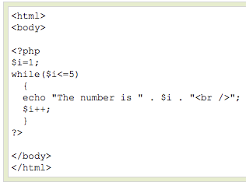
PHP Loops - While
The while loop executes a block of code while a condition is true. The example below defines a loop that starts with
i=1. The loop will
continue to run as
long as i is less
than, or equal to 5.
i will increase by 1
each time the loop
runs:

Slide 21
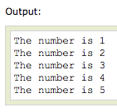
PHP Loops - While

Slide 22
PHP Loops – Do ... While
The do...while statement will always execute the block of code once, it will then check the condition, and repeat the loop while the condition is true.
The next example defines a loop that starts with i=1. It will then increment i with 1, and write some output. Then the condition is checked, and the loop will continue to run as long as i is less than, or equal to 5:

Slide 23
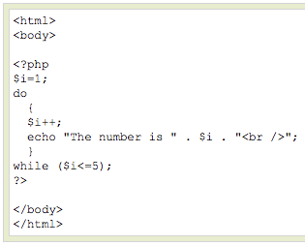
PHP Loops – Do ... While

Slide 24
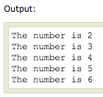
PHP Loops – Do ... While

Slide 25
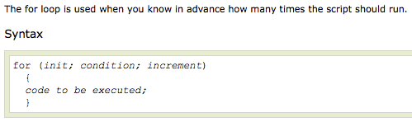
PHP Loops - For

Slide 26
PHP Loops - For
Parameters:
> init: Mostly used to set a counter (but can be any code to be executed once at the beginning of the loop)‏
> condition: Evaluated for each loop iteration. If it evaluates to TRUE, the loop continues. If it evaluates to FALSE, the loop ends.
> increment: Mostly used to increment a counter (but can be any code to be executed at the end of the loop)‏

Slide 27
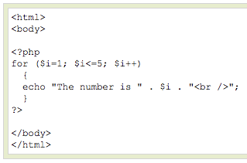
PHP Loops - For
The example below defines a loop that starts with i=1. The loop will continue to run as long as i is less than, or equal to 5. i will increase by 1 each time the loop runs:

Slide 28
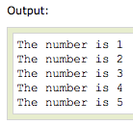
PHP Loops - For

Slide 29

PHP Loops - Foreach
For every loop iteration, the value of the current array element is assigned to $value (and the array pointer is moved by one) - so on the next loop iteration, you'll be looking at the next array value.

Slide 30
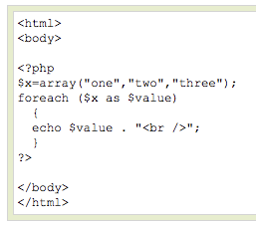

PHP Loops - Foreach
The following example demonstrates a loop that will print the values of the given array:

Slide 31
break, continue, return
break
Ends execution of current for, foreach, do … while, while or switch structure
Option: Number of nested structures to break out of
continue
Skip rest of current loop
Option: Number of nested loops to skip
return
Ends execution of current function/statement/script
Notes:
break
ends execution of the current for, foreach while, do..while or switch structure.
accepts an optional numeric argument which tells it how many nested enclosing structures are to be broken out of.
e.g break(3) to break out of three nested structures
continue
used within looping structures to skip the rest of the current loop iteration and continue execution at the beginning of the next iteration.
accepts an optional numeric argument which tells it how many levels of enclosing loops it should skip to the end of.
NB. Switch statement is considered a loop for the purposes of continue
return
When called will end the execution of a function (if within a function), an eval() statement or otherwise the current script file.
Returns it’s argument as the value of the function cal

Slide 32
Indentation..
Code readability IS important – notice how all the code inside a loop/control structure is indented.
Once you start writing nested control loops, indentation is the only way to keep track of your code!

Slide 33
Code Re-use
Often you will want to write a piece of code and re-use it several times (maybe within the same script, or maybe between different scripts).
Functions are a very nice way to encapsulate such pieces of code..

Slide 34
Eh..? What?
You have already used functions..
echo(‘text to display’);
Function NAME
Function ARGUMENT

Slide 35
What is a function?
A function takes some arguments (inputs) and does something with them (echo, for example, outputs the text input to the user).
As well as the inbuilt PHP functions, we can define our own functions..

Slide 36
Definition vs. Calling
There are two distinct aspects to functions:
Definition: Before using a function, that function must be defined – i.e. what inputs does it need, and what does it do with them?
Calling: When you call a function, you actually execute the code in the function.

Slide 37
Function Definition
A function accepts any number of input arguments, and returns a SINGLE value.
function myfunction($arg1,$arg2,…,$argN)
{
statements;
return $return_value;
}

Slide 38
Example
Function to join first and last names together with a space..
function make_name($first,$last)
{
$fullname = $first.’ ‘.$last;
return $fullname;
}

Slide 39
Calling functions..
Can be done anywhere..
myfunction($arg1,$arg2,…,$argN)
or
$answer = myfunction($arg1,$arg2,…,$argN)
e.g.
echo make_name(‘Rob’,’Tuley’);
// echoes ‘Rob Tuley’

Slide 40
Functions: Return Values
Use return
Causes execution of function to cease
Control returns to calling script
To return multiple values
Return an array
If no value returned
NULL
Notes:
EXAMPLES (functions.php)
function say_welcome()
{
echo 'Welcome!';
}
say_welcome();
echo '<br />';
function say_welcome2($name)
{
echo "Welcome $name!";
}
say_welcome2('Simon');
echo '<br />';
function say_welcome3($name)
{
return "Welcome $name!";
}
echo say_welcome3('Simon');
echo '<br />';
$welcome = say_welcome3('Simon');
echo $welcome;
echo '<br />';
function say_welcome4($name1, $name2, $name3, $name4)
{
$welcome_array = array("Welcome $name1!", "Welcome $name2!", "Welcome $name3!", "Welcome $name4!");
return $welcome_array;
}
foreach (say_welcome4('Simon', 'Rob', 'Steve', 'John') as $value)
{
echo "$value<br />";
}

Slide 41
‘Scope’
A function executes within its own little protected bubble, or local scope.
What does this mean? Its means that the function can’t ‘see’ any of the variables you have defined apart from those passed in as arguments..
Each new function call starts a clean slate in terms of internal function variables.

Slide 42
In other words..
Variables within a function
Are local to that function
Disappear when function execution ends
Variables outside a function
Are not available within the function
Unless set as global
Remembering variables
Not stored between function calls
Unless set as static

Slide 43
Global variables..
To access a variable outside the ‘local’ scope of a function, declare it as a global:
function add5toa()
{
global $a;
$a = $a + 5;
}
$a = 9;
add5toa();
echo $a; // 14

Slide 44
Static Variables
Local function variable values are not saved between function calls unless they are declared as static:
function counter()
{
static $num = 0;
return ++$num;
}
echo counter(); // 1
echo counter(); // 2
echo counter(); // 3

Slide 45
Default Arguments
Can specify a default value in the function definition which is used only if no value is passed to the function when called..
Defaults must be specified last in the list
function myfunction($arg1,$arg2=‘blah’)…
function myfunction($arg1=‘blah’,$arg2)…

Slide 46
Passing References
Pass a reference to a variable
Not the actual variable
Why?
Enables a function to modify its arguments
How?
Use an ampersand in front of the variable
&$variable
Notes:
Example of passing a reference… IN funtions.php
function add_some_extra(&$string) { $string .= 'and something extra.'; }
$str = 'This is a string, ';
add_some_extra($str);
echo $str; // outputs 'This is a string, and something extra.'
$str is actually modified by the function which would not have worked if just the variable had been passed. Basically you are telling the function where to find the actual variable (i.e. its address) rather than giving it a copy to use.

Slide 47
Passing References
Example of passing a reference… IN funtions.php
function add_some_extra(&$string) { $string .= 'and something extra.'; }
$str = 'This is a string, ';
add_some_extra($str);
echo $str; // outputs 'This is a string, and something extra.'
$str is actually modified by the function which would not have worked if just the variable had been passed. Basically you are telling the function where to find the actual variable (i.e. its address) rather than giving it a copy to use.

Slide 48
Passing References
$str is actually modified by the function which would not have worked if just the variable had been passed. Basically you are telling the function where to find the actual variable (i.e. its address) rather than giving it a copy to use.

Slide 49
END

